Slide 1
Study the DyRep and JODIE
Run wiki/reddit for multiple trials and extract samples that are consistently predicted wrongly in the experiments.

Slide 2
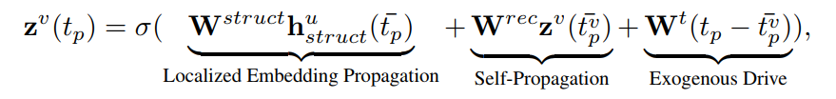

DyRep
Training procedure:
refer to “Know-evolve: Deep temporal reasoning for dynamic knowledge graph”
mini-batch & BPTT to train the model

Slide 3
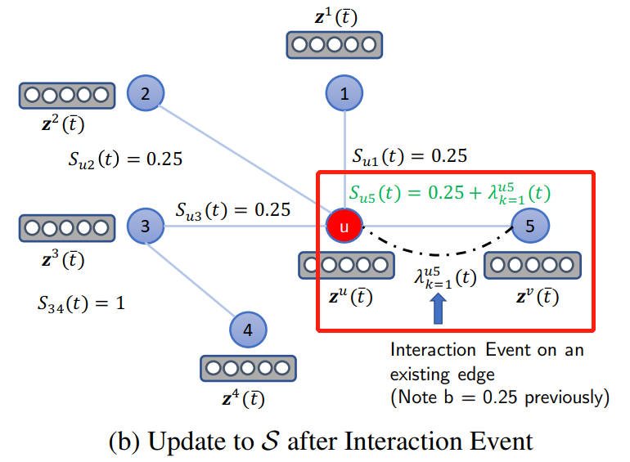
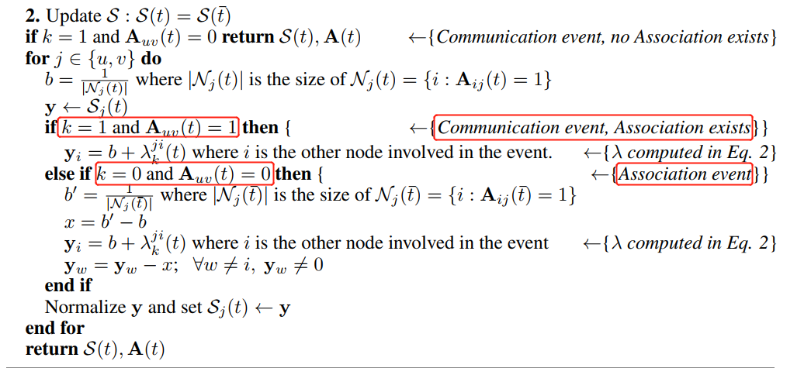
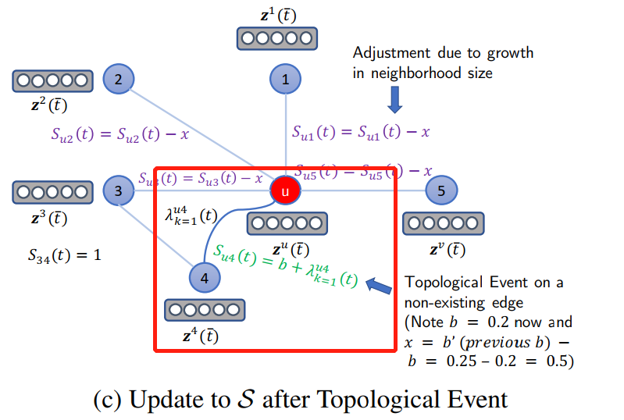
DyRep

Slide 4
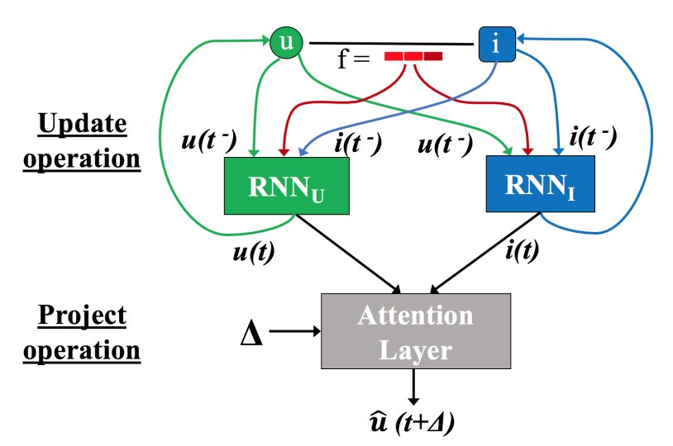
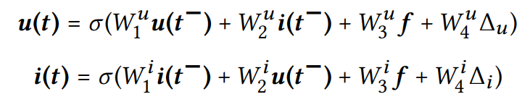

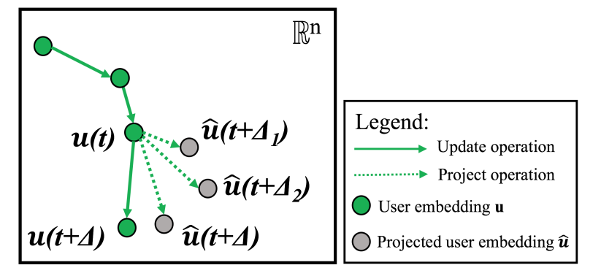
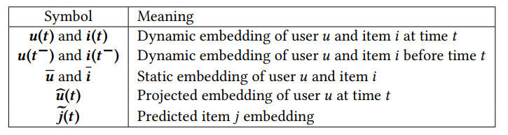
JODIE
Training procedure: t-batch
select step: a new batch is created by selecting the maximal edge set such that each edge (u,i) is the lowest timestamped edge incident on both u and i.
reduce step: the selected edges are removed from the network.

Slide 5
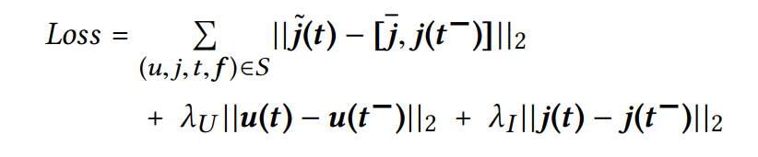
JODIE
Predict which other items users will interact with in the time period t~t+Δ

Slide 6
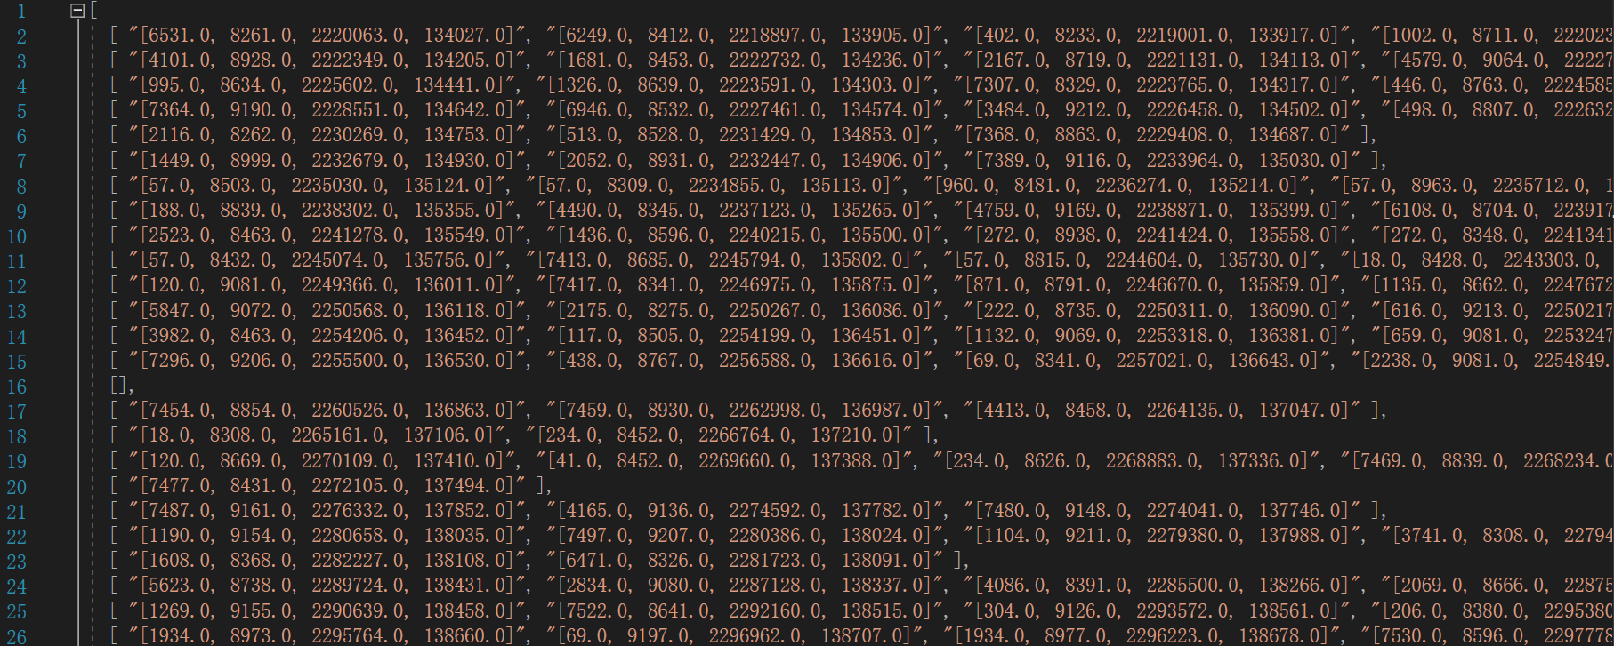
Samples that are consistently predicted wrongly (TGN)
{user_id, item_id, timestamp, edge_id}

